Slide 1


Insecure
Timid
Shy
Anxious
Lost
Astonished
Startled
Uncertain

Slide 2
Worried
Panicky
Terrified
Petrified
Frightened
Horrified
Terror-Stricken

Slide 3
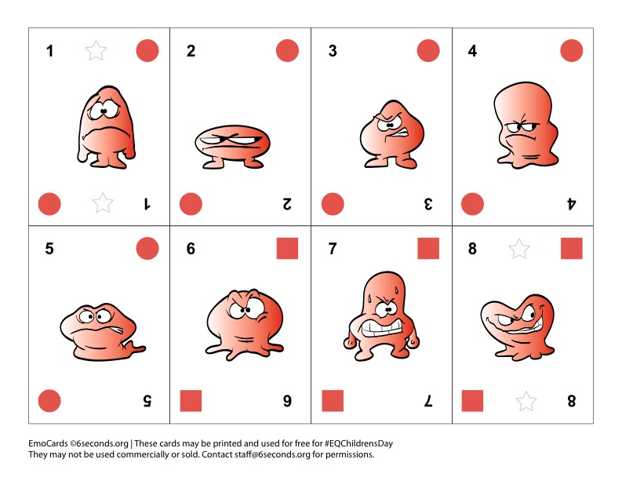
Disappointed
Peeved
Miffed
Annoyed
Irritated
Critical
Angry
Vindictive

Slide 4
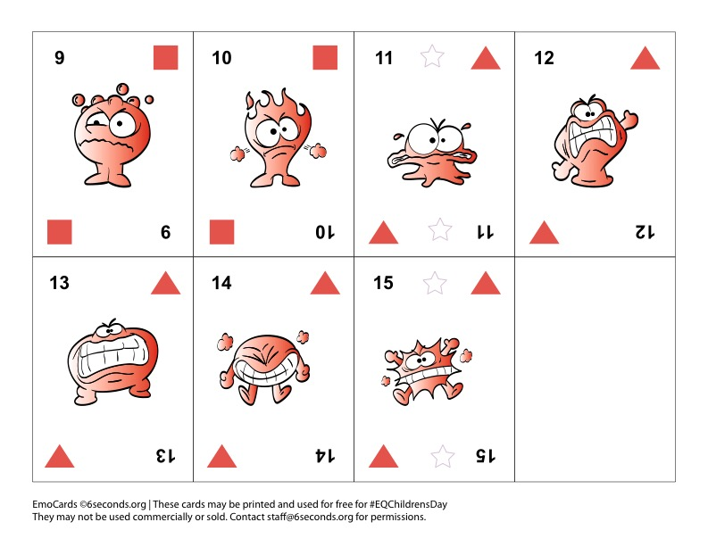
Boiling
Fuming
Livid
Infuriated
Outraged
Furious
Explosive

Slide 5
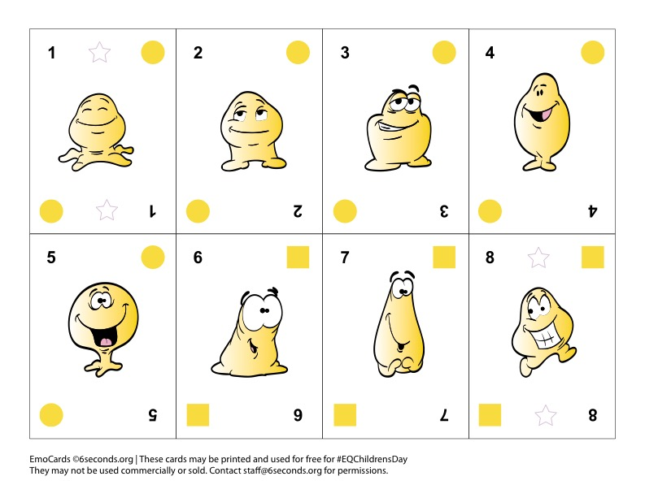
Peaceful
Content
Confident
Pleased
Happy
Hopeful
Delighted
Cheerful

Slide 6
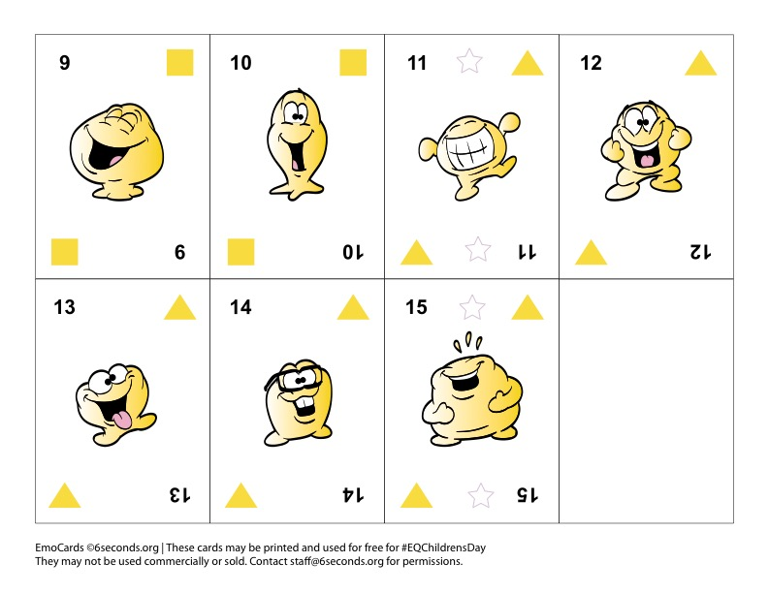
Joyful
Thrilled
Ecstatic
Exuberant
Wacky
Goofy
Hilarious

Slide 7
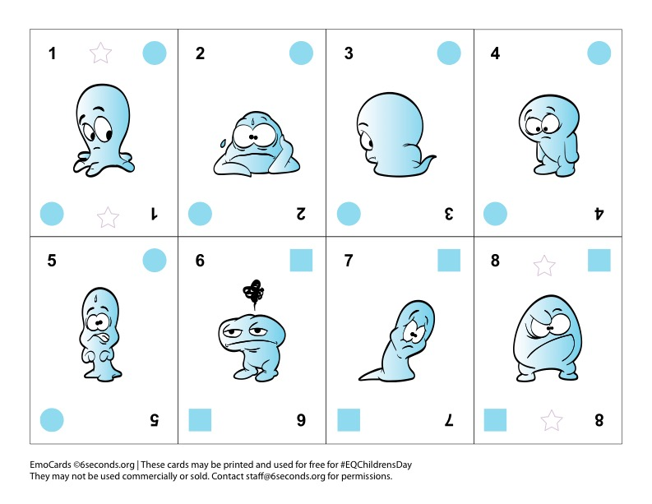
Insignificant
Overwhelmed
Withdrawn
Lonely
Disturbed
Gloomy
Sad
Discouraged

Slide 8
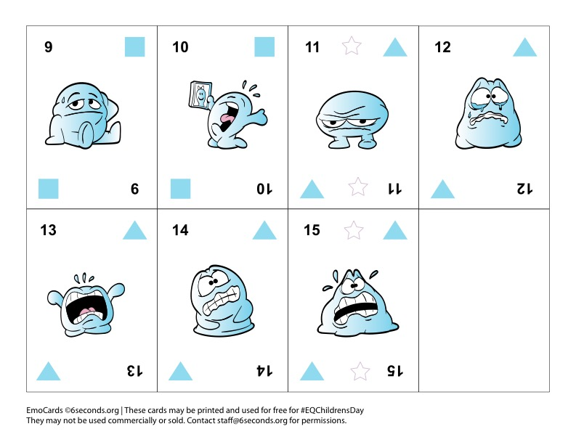
Defeated
Heartbroken
Miserable
Anguished
Grief-stricken
Devastated
Distraught

